Slide 1
More on Specification and Data Issues

Slide 2
More on Specification and Data Issues
Tests for functional form misspecification
  One can always test whether explanatory should appear as squares or higher order terms by testing whether such terms can be excluded
  Otherwise, one can use general specification tests such as RESET
Regression specification error test (RESET)
  The idea of RESET is to include squares and possibly higher order fitted values in the regression (similarly to the reduced White test)
Test for the exclusion of these terms. If they cannot be excluded, this is evidence for omitted higher order terms and interactions, i.e. for misspecification of functional form.

Slide 3
More on Specification and Data Issues
Example: Housing price equation
Discussion
  One may also include higher order terms, which implies complicated interactions and higher order terms of all explanatory variables
  RESET provides little guidance as to where misspecification comes from
Evidence for
misspecification
Less evidence for
misspecification

Slide 4
More on Specification and Data Issues
Testing against nonnested alternatives
Discussion
  Can always be done; however, a clear winner need not emerge
  Cannot be used if the models differ in their definition of the dep. var.
Which specification
is more appropriate?
Model 1:
Model 2:
Define a general model that contains both models as subcases and test:

Slide 5

More on Specification and Data Issues
Using proxy variables for unobserved explanatory variables
Example: Omitted ability in a wage equation
General approach to use proxy variables
Replace by proxy
In general, the estimates for the returns to education and experience will be biased because one has omit the unobservable ability variable. Idea: find a proxy variable for ability which is able to control for ability differences between individuals so that the coefficients of the other variables will not be biased. A possible proxy for ability is the IQ score or similar test scores.
Omitted variable, e.g. ability
Regression of the omitted variable on its proxy

Slide 6

More on Specification and Data Issues
Assumptions necessary for the proxy variable method to work
  The proxy is “just a proxy” for the omitted variable, it does not belong into the population regression, i.e. it is uncorrelated with its error
  The proxy variable is a “good” proxy for the omitted variable, i.e. using other variables in addition will not help to predict the omitted variable
If the error and the proxy were correlated, the proxy would actually have to be included in the population regression function

Slide 7
More on Specification and Data Issues
Under these assumptions, the proxy variable method works:
Discussion of the proxy assumptions in the wage example
  Assumption 1: Should be fullfilled as IQ score is not a direct wage determinant
  Assumption 2: Most of the variation in ability should be explainable by variation in IQ score, leaving no rest to educ and exper
In this regression model, the error term is uncorrelated with all the explanatory variables. As a consequence, all coefficients will be correctly estimated using OLS. The coefficents for the explanatory variables x₁ and x₂ will be correctly identified. The coefficient for the proxy va-riable may also be of interest (it is a multiple of the coefficient of the omitted variable).

Slide 8
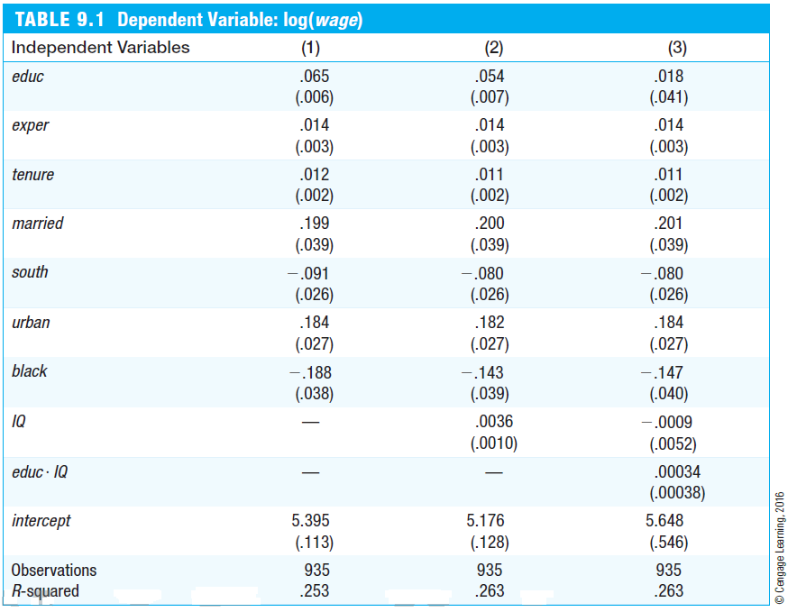
More on Specification and Data Issues
As expected, the measured return to education decreases if IQ is included as a proxy for unobserved ability.
The coefficient for the proxy suggests that ability differences between indivi-duals are important (e.g. +15 points IQ score are associated with a wage increase of 5.4 percentage points).
Even if IQ score imperfectly soaks up the variation caused by ability, inclu-ding it will at least reduce the bias in the measured return to education.
No significant interaction effect bet-ween ability and education.

Slide 9
More on Specification and Data Issues
Using lagged dependent variables as proxy variables
  In many cases, omitted unobserved factors may be proxied by the value of the dependent variable from an earlier time period
Example: City crime rates
  Including the past crime rate will at least partly control for the many omitted factors that also determine the crime rate in a given year
  Another way to interpret this equation is that one compares cities which had the same crime rate last year; this avoids comparing cities that differ very much in unobserved crime factors

Slide 10
More on Specification and Data Issues
Models with random slopes (= random coefficient models)
The model has a random intercept and a random slope
Average intercept
Random component
Average slope
Random component
Error term
The individual random com-ponents are independent of the explanatory variable
Assumptions:
WLS or OLS with robust standard errors will consistently estimate the average intercept and average slope in the population

Slide 11

More on Specification and Data Issues
Properties of OLS under measurement error
Measurement error in the dependent variable
Consequences of measurement error in the dependent variable
  Estimates will be less precise because the error variance is higher
  Otherwise, OLS will be unbiased and consistent (as long as the mea-surement error is uncorrelated to the values of the explanatory variables)
Mismeasured value = True value + Measurement error
Population regression
Estimated regression

Slide 12


More on Specification and Data Issues
Measurement error in an explanatory variable
Mismeasured value = True value + Measurement error
Population regression
Estimated regression
Error uncorrelated to true value
Classical errors-in-variables assumption:
The mismeasured variable x₁ is cor-related with the error term

Slide 13

More on Specification and Data Issues
Consequences of measurement error in an explanatory variable
  Under the classical errors-in-variables assumption, OLS is biased and inconsistent because the mismeasured variable is endogenous
  One can show that the inconsistency is of the following form:
  The effect of the mismeasured variable suffers from attenuation bias, i.e. the magnitude of the effect will be attenuated towards zero
  In addition, the effects of the other explanatory variables will be biased
This factor (which involves the error variance of a regression of the true value of x₁ on the other explanatory variables) will always be between zero and one

Slide 14
More on Specification and Data Issues
Missing data and nonrandom samples
Missing data as sample selection
  Missing data is a special case of sample selection (= nonrandom sampling) as the observations with missing information cannot be used
  If the sample selection is based on independent variables there is no problem as a regression conditions on the independent variables
  In general, sample selection is no problem if it is uncorrelated with the error term of a regression (= exogenous sample selection)
  Sample selection is a problem, if it is based on the dependent variable or on the error term (= endogenous sample selection)

Slide 15
More on Specification and Data Issues
Example for exogenous sample selection
Example for endogenous sample selection
If the sample was nonrandom in the way that certain age groups, income groups, or household sizes were over- or undersampled, this is not a problem for the regression because it examines the savings for subgroups defined by income, age, and hh-size. The distribution of subgroups does not matter.
If the sample is nonrandom in the way individuals refuse to take part in the sample survey if their wealth is particularly high or low, this will bias the regression results because these individuals may be systematically different from those who do not refuse to take part in the sample survey.

Slide 16
More on Specification and Data Issues
Outliers and influential observations
  Extreme values and outliers may be a particular problem for OLS because the method is based on squaring deviations
  If outliers are the result of mistakes that occured when keying in the data, one should just discard the affected observations
  If outliers are the result of the data generating process, the decision whether to discard the outliers is not so easy
Example: R&D intensity and firm size

Slide 17
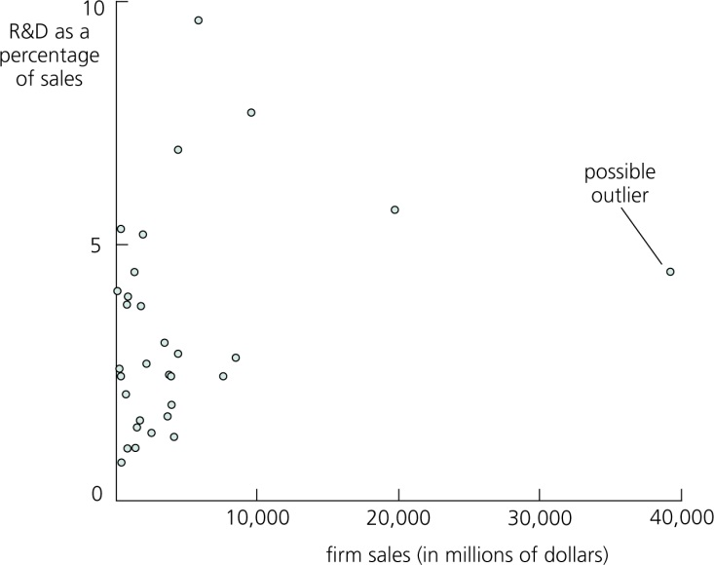
More on Specification and Data Issues
Example: R&D intensity and firm size (cont.)
The outlier is not the result of a mistake: One of the sampled firms is much larger than the others.
The regression without the outlier makes more sense.

Slide 18

More on Specification and Data Issues
Least absolute deviations estimation (LAD)
  The least absolute deviations estimator minimizes the sum of absolute deviations (instead of the sum of squared deviations, i.e. OLS)
  It may be more robust to outliers as deviations are not squared
  The least absolute deviations estimator estimates the parameters of the conditional median (instead of the conditional mean with OLS)
  The least absolute deviations estimator is a special case of quantile regression, which estimates parameters of conditional quantiles

